Slide 1

MEMORIES
LECTURE : SO Vengleab
SUBJECT : Web Development
with Framework

Slide 2
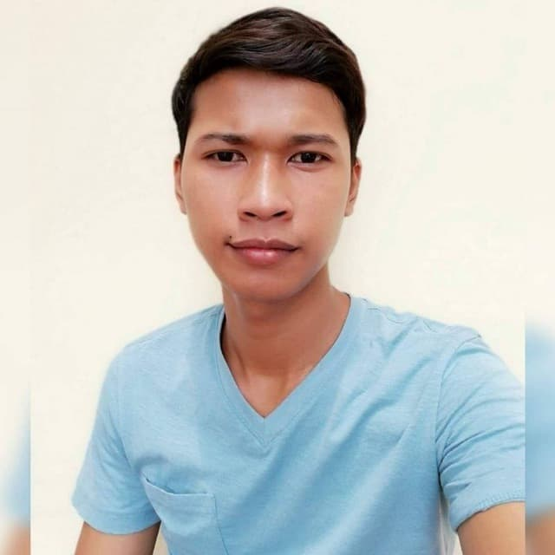
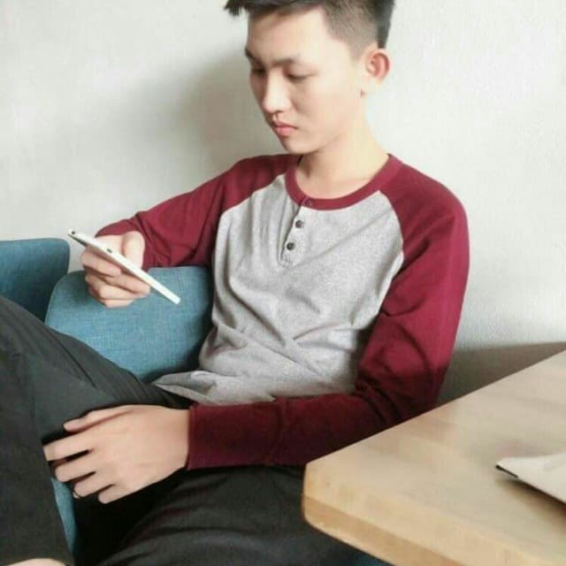

TEAM CREATOR CONTRIBUTION
OUM SOKNANG: 30%
Leader of the project memories
CHHAY LANG: 30%
KOIY BOTTRA: 30%
Member of the project memories
Member of the project memories

Slide 3
Agenda
INTRODUCTION
PROJECT FEATURE
PROBLEM AND SOLUTION
PROJECT DEVELOP TOOL
CONCLUSION
PROJECT DEMONSTRATOR
Q & A

Slide 4

INTRODUCTION
MEMORIES
We advertise this project Memories for someone who like to sharing of the experience after they have been travel or go to somewhere or recommend to someone Especially when other sharing of they memories we feel like bring us in to there experiences.

Slide 5
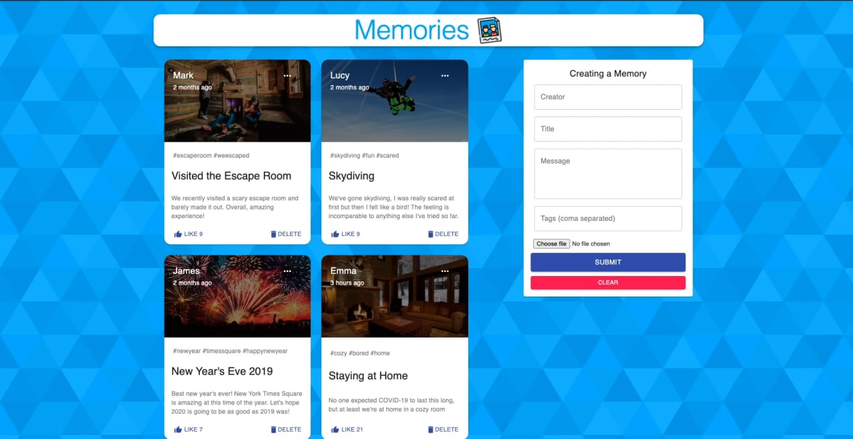
PROJECT FEATURE
FEARTURE OF THIS PROJECT ARE :

Slide 6
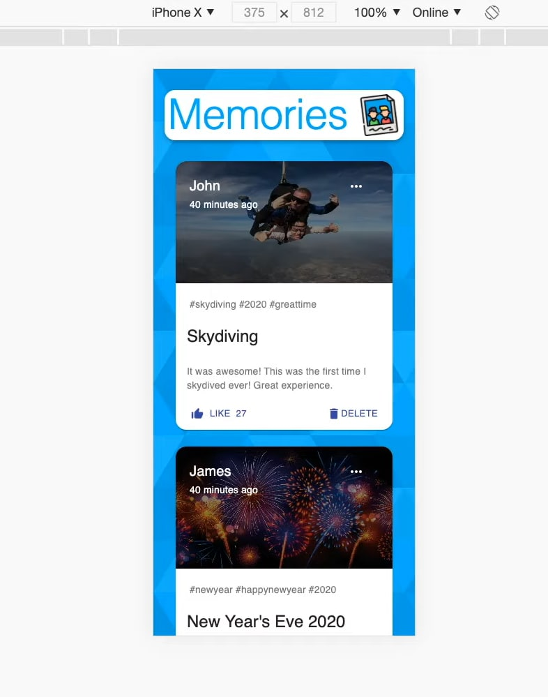
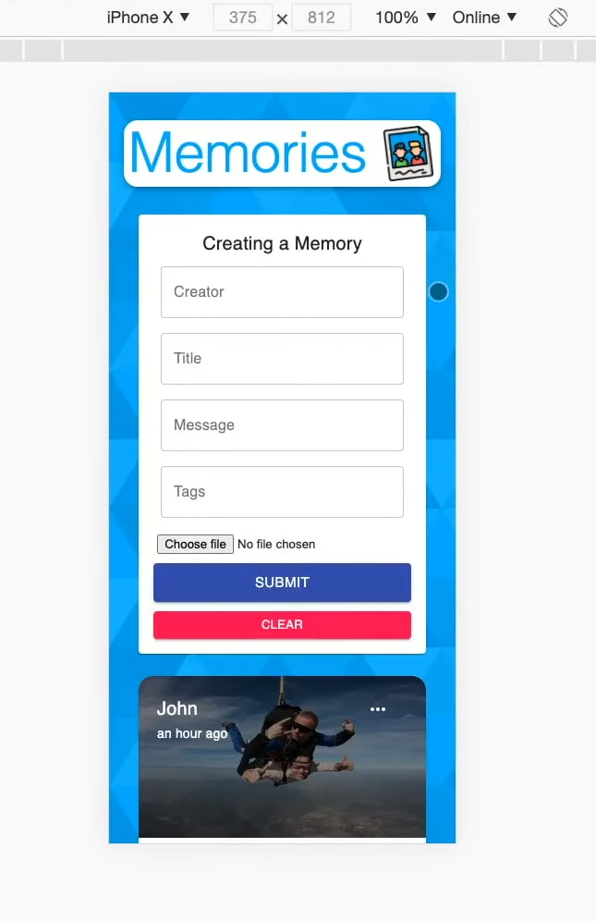

Slide 7
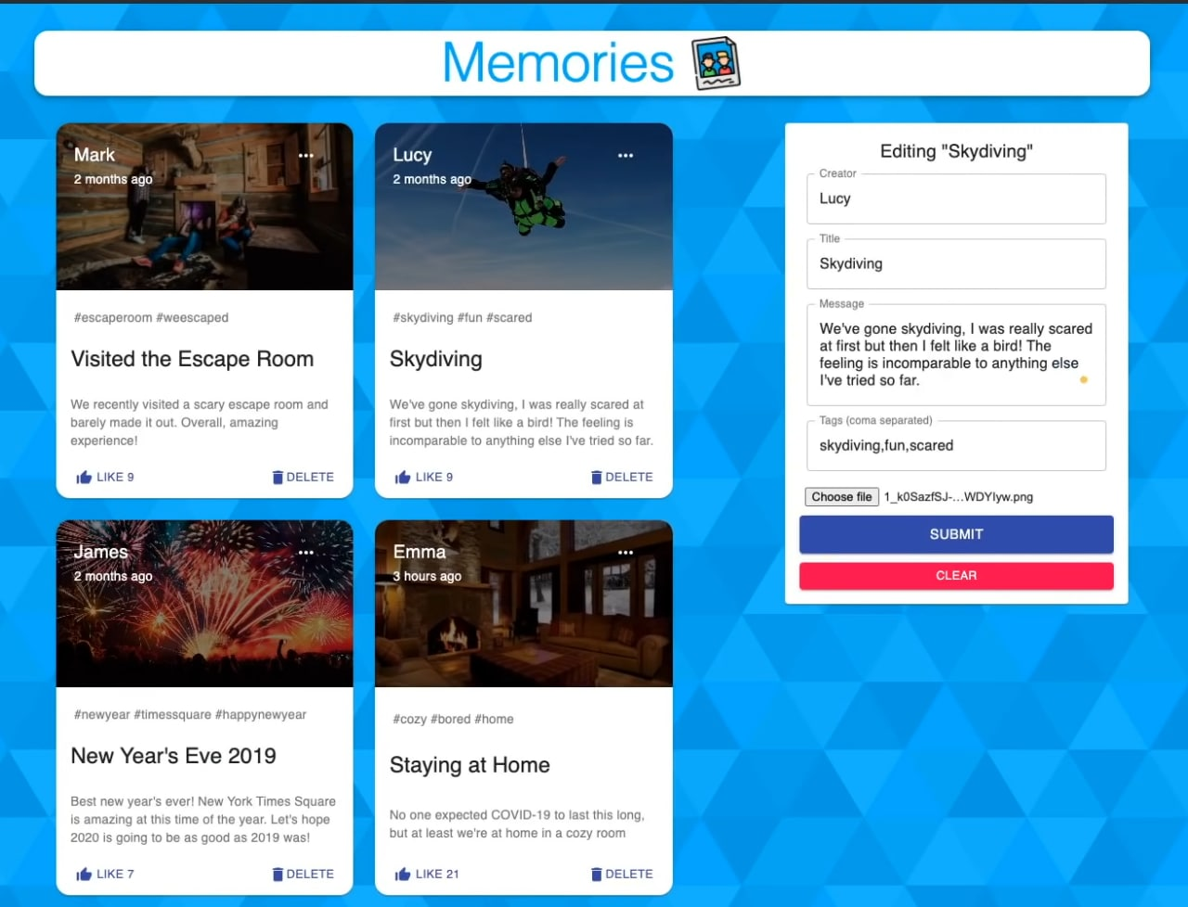

Slide 8

PROBLEM OF THE PROJECT
Problems
ERROR
NEW EXPERIENCES
TIME
SHARING
HANDLE THE PROBLEM

Slide 9




PROJECT DEVELOPMENT TOOL

Slide 10
CONCLUSION

Slide 11


PROJECT DEMONSTRATOR
DEMO PROJECT

Slide 12

QUESTION AND ANSWER

